Slide 1
Tech Interview Prep:
Core LLM Foundations & Systems Architecture
“Explain how tokenization works, how context window limits affect application architecture, and why Large Language Models exhibit non-deterministic behavior.”
Title & Architectural Roadmap
Title: Deconstructuring the LLM Runtime: Tokenization, Context Scaling, and Determinism
1) Tokenization (how text becomes tokens)
2) Context Window (why context window has limits)
3) Non-Determinism (why outputs are different for same prompts)
Name: Dara Sen
Class: AD331 (Artificial Intelligence)

Slide 2
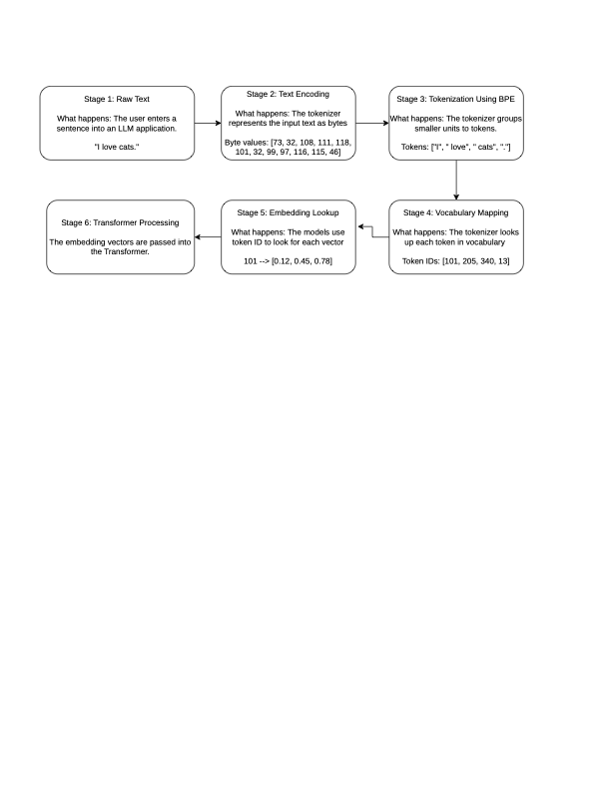
Deep-Dive: Tokenization Under the Hood

Slide 3
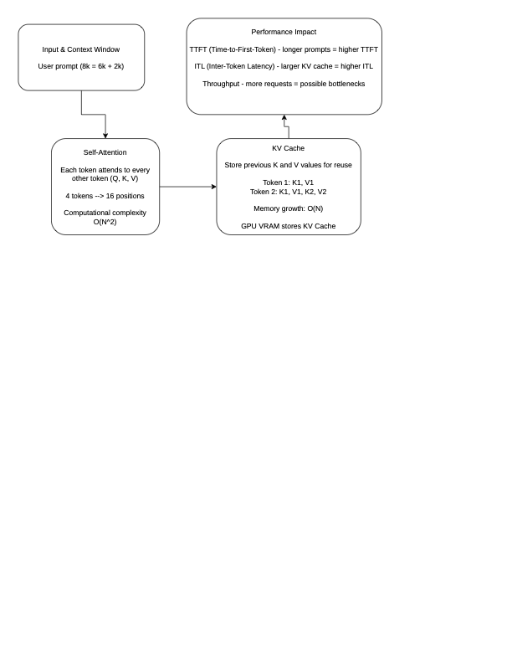
Context Windows: Computational Bounds & Memory Scaling

Slide 4
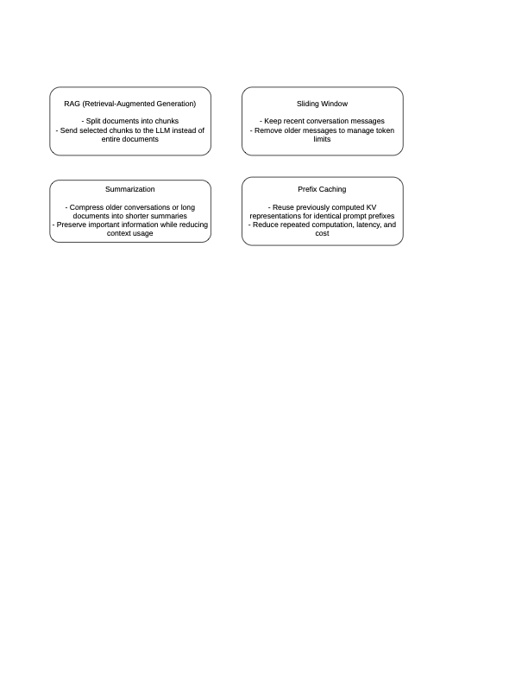
Application Architecture for Finite & Large Contexts
Finite Context (Short Context) – Use the model’s context window directly
Large Context (Long Context) – Use an architectural pattern to handle more info

Slide 5
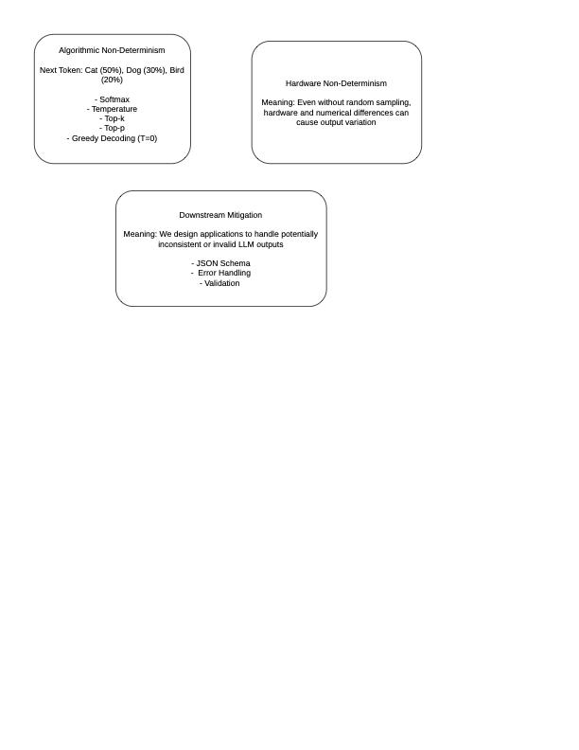
Destructuring Non-Determinism: Algorithmic & Hardware Layers

Slide 6
Summary & Systems Engineering Takeaways
Tokenization – Manage token budgets to optimize API costs, latency
Context Windows – Optimize GPU memory and inference performance using KV Caching, RAG, Summarization.
Non-Determinism - Use JSON Schema validation, and error handling

